Slide 1
Shut Your Pi-Hole
Testival Meetup #45
Renato Ćurić \\ 12.02.2019.

Slide 2
What is a Pi-Hole?
Pi-hole is a Linux network-level advertisement and internet tracker blocking application which acts as a DNS sinkhole, intended for use on a private network
Created for embedded systems but can be used on other devices running Linux
Can also block adverts in unconventional positions, such as on Android, iOS and smart TVs
Open source

Slide 3
How does it work?
Imagine Pi-Hole as a traditional firewall that blocks advertisements for all devices connected to the same network as the Pi-Hole, where traditional ad blockers run inside the user’s browser
DNS server for private networks
Has lists of advert and tracking domains from predefined sources
Refuse to resolve requested domain and respond to the requesting device with a blank webpage
Blacklist/Whitelist

Slide 4
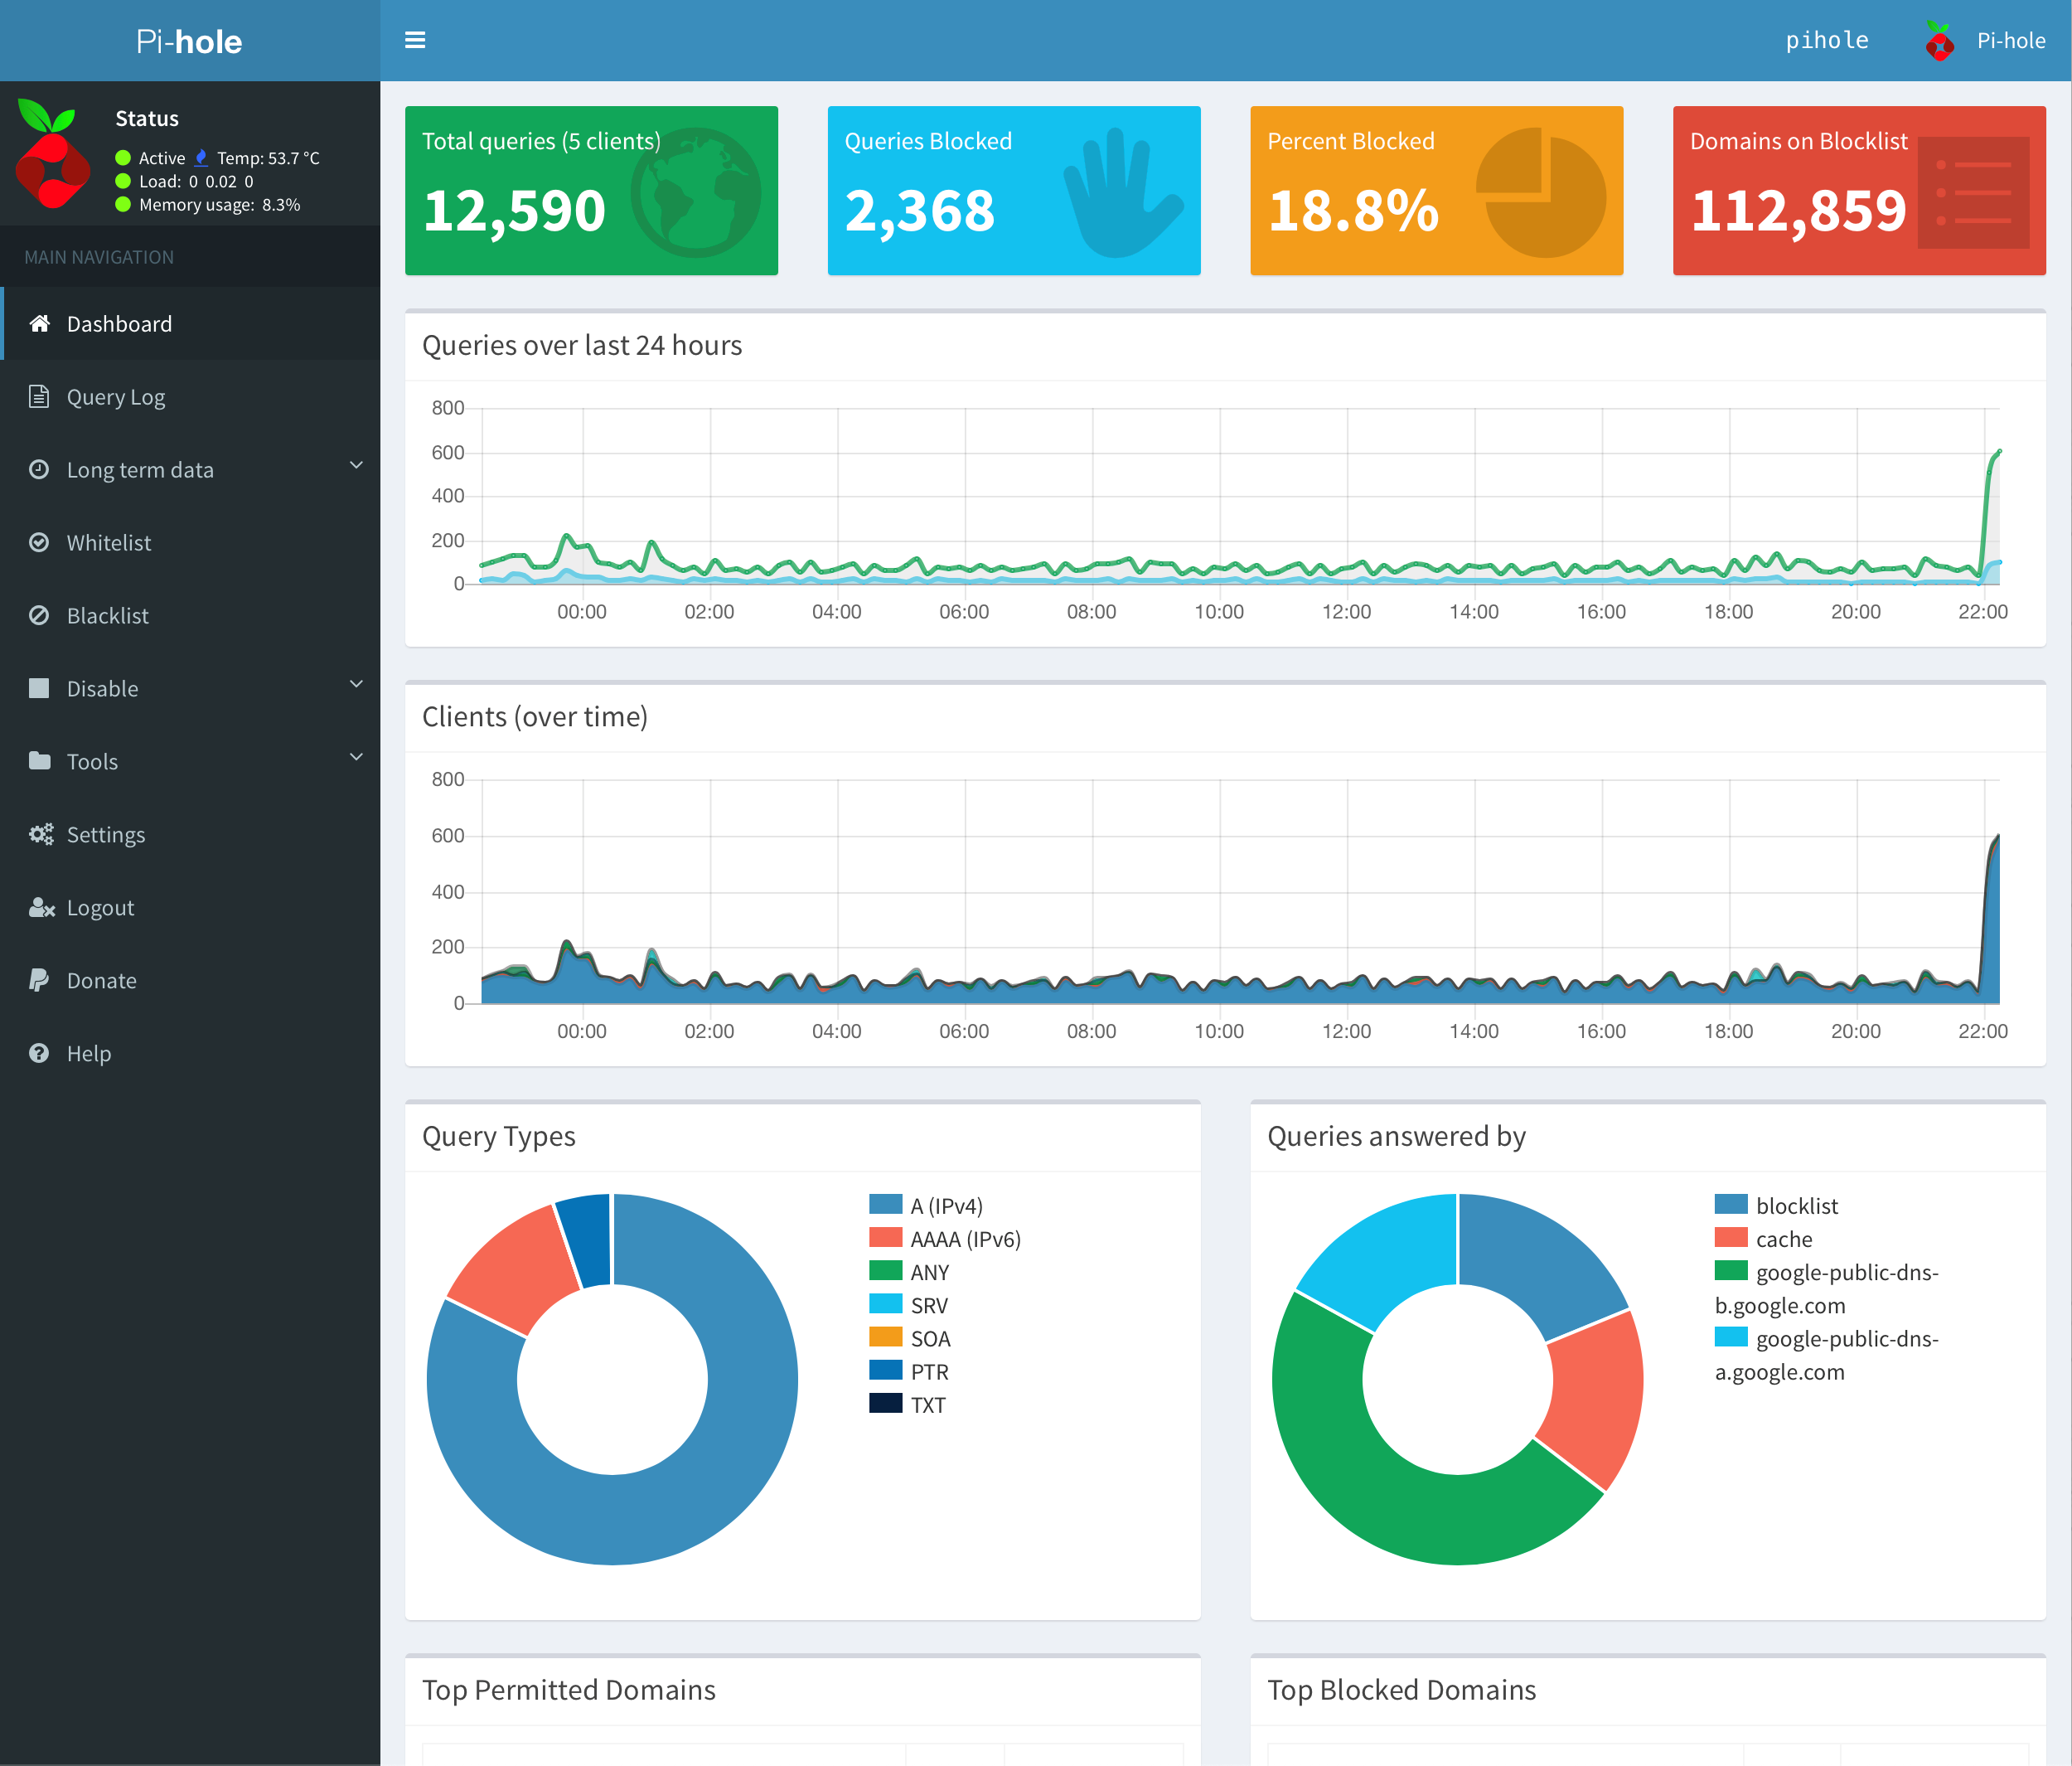
Dashboard

Slide 5

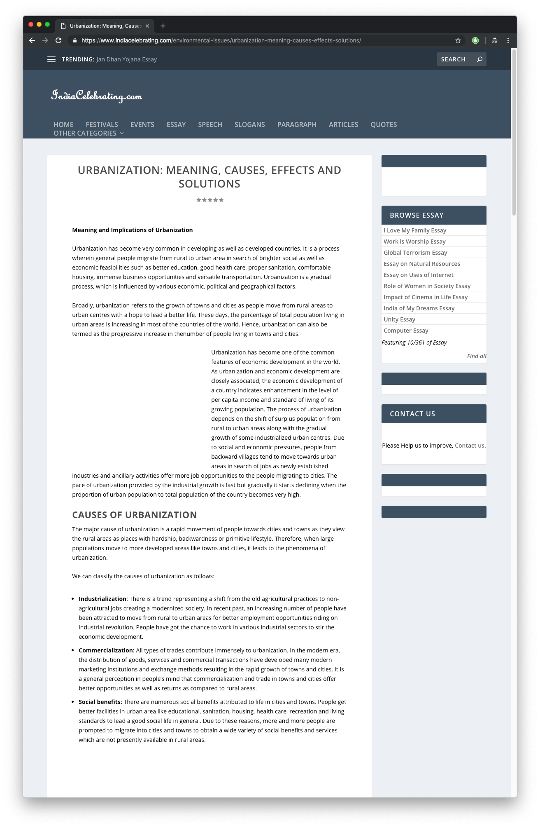
In Action Part 1
Notes:
Indiacelebrating.com

Slide 6
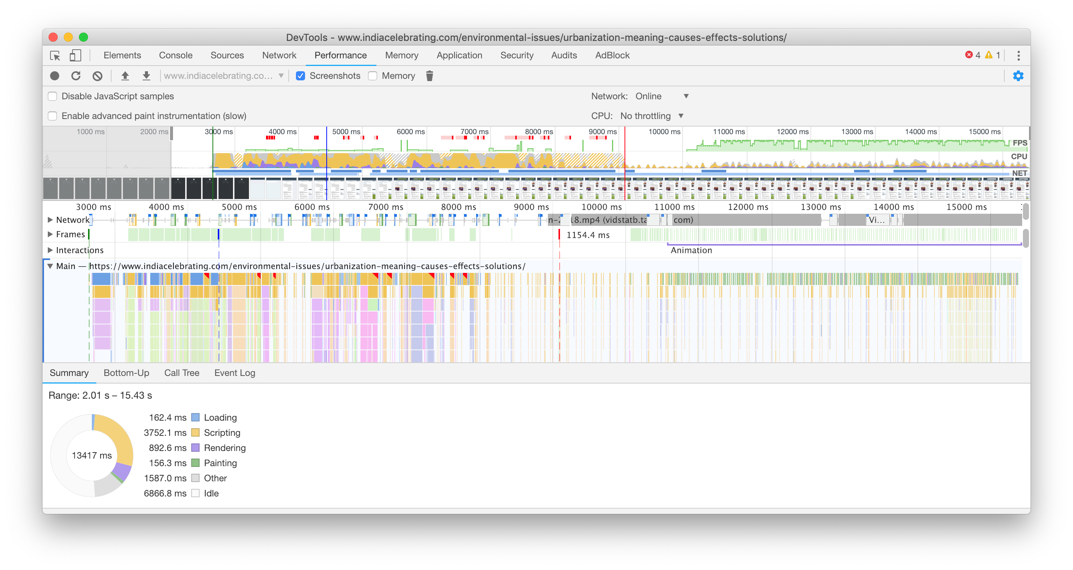
In Action Part 1

Slide 7
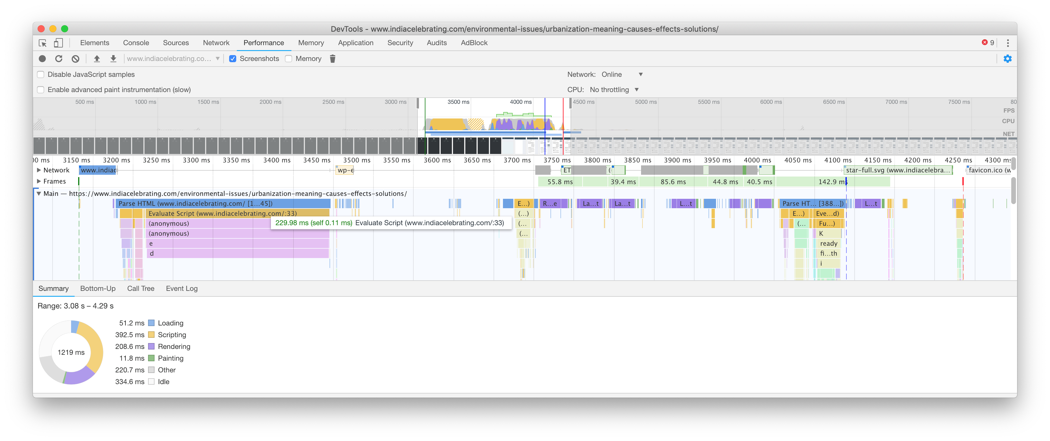
In Action Part 1

Slide 8
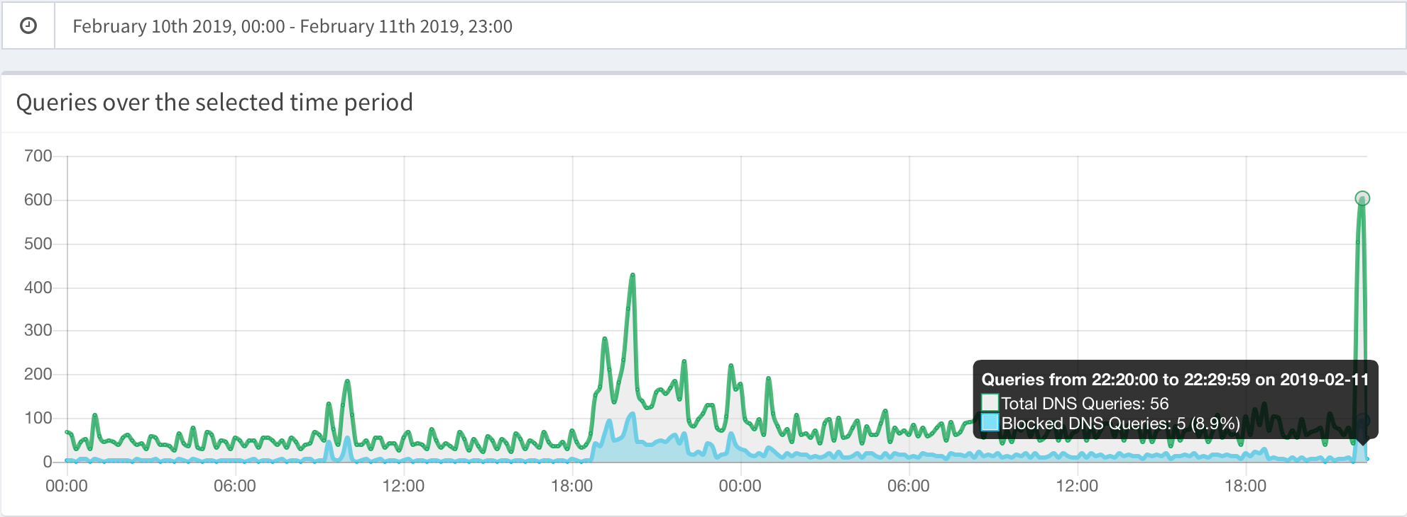
Statistics

Slide 9


In Action Part 2

Slide 10

In Action Part 2

Slide 11
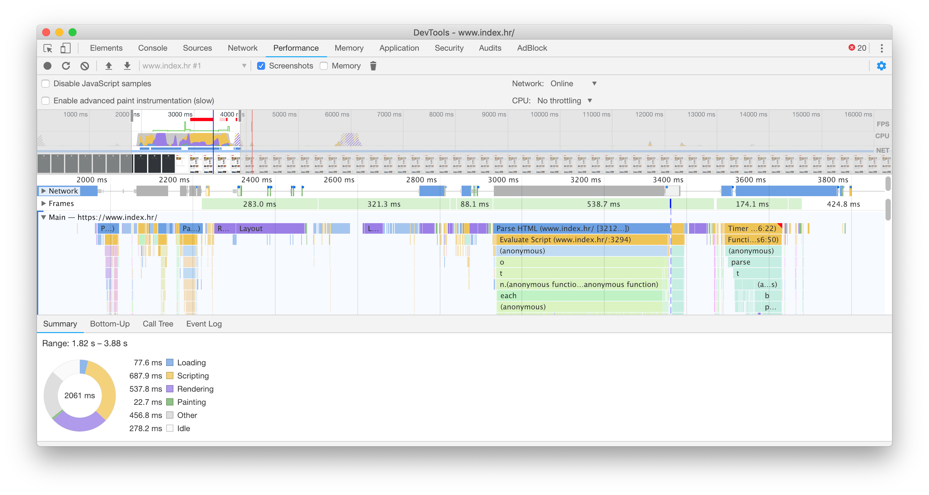
In Action Part 2

Slide 12

Cheers

